Slide 1
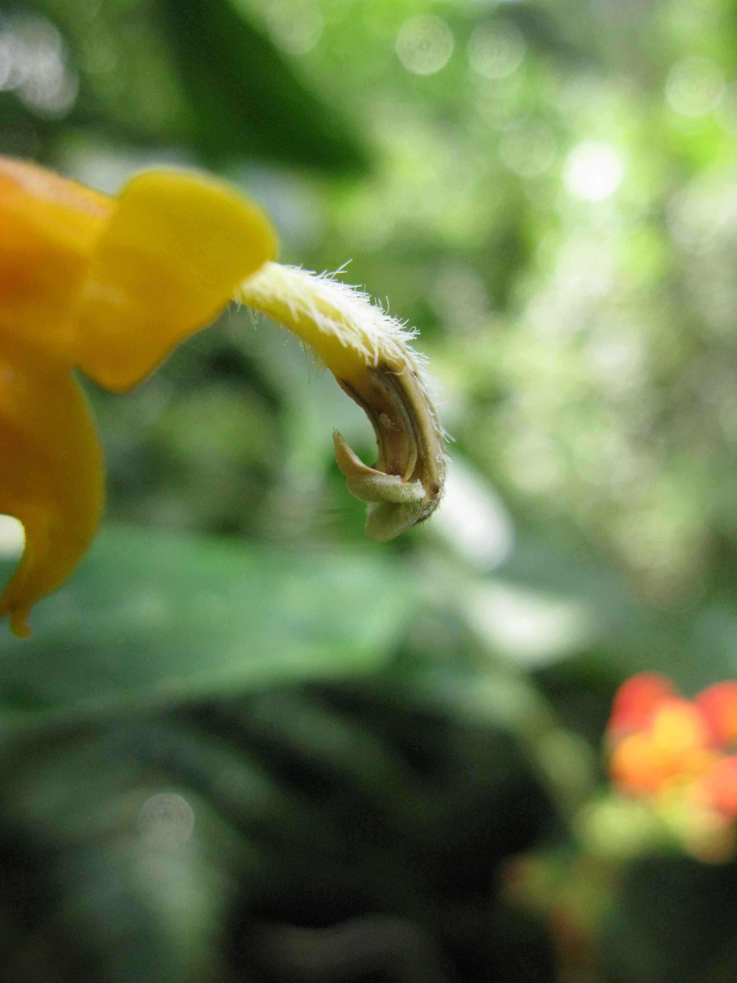

Slide 2
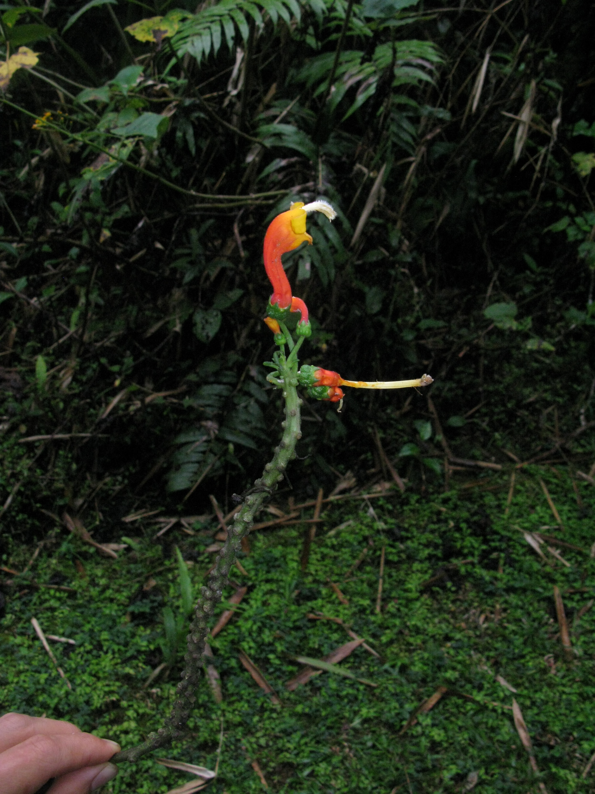

Slide 3
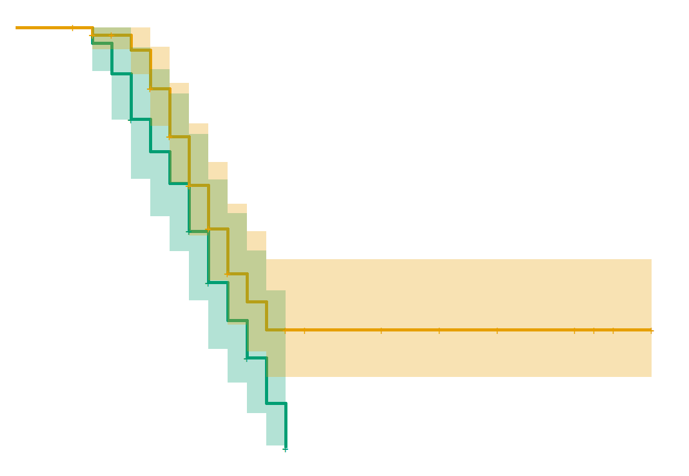
1.00
Hummingbirds excluded
Control
0.80
Survival probability
0.50
0.25
0.00
0
10
20
30
Time (days from anthesis)

Slide 4
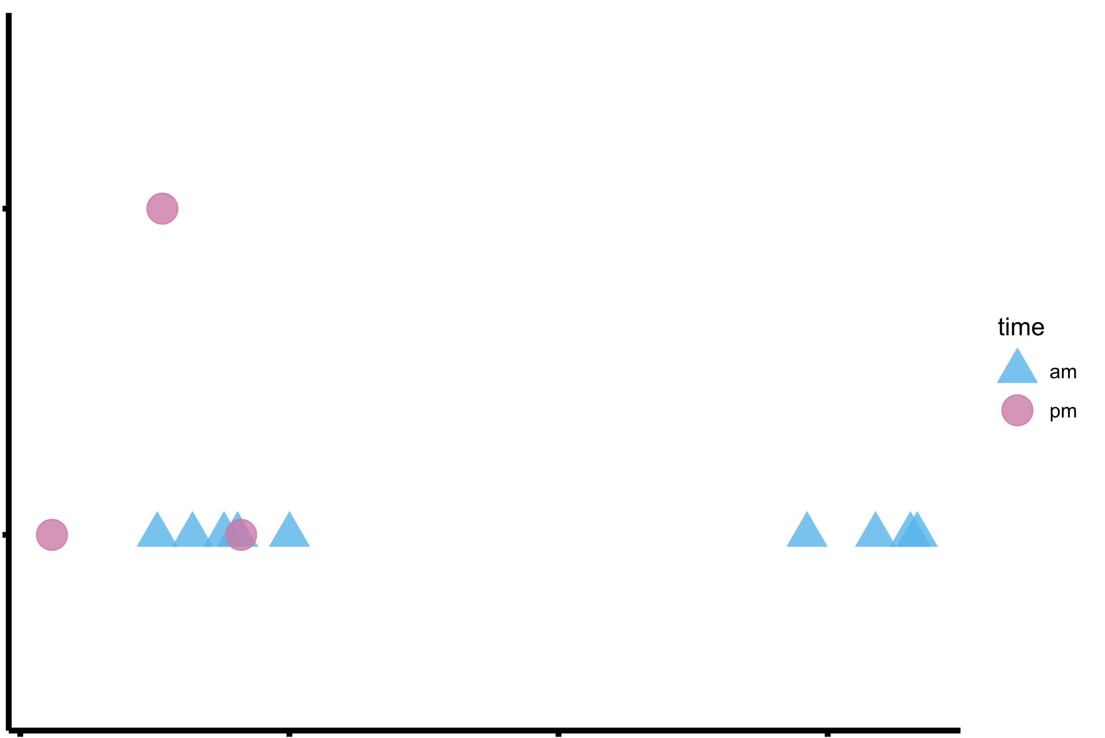
2
Number of daily visits
Time of day
A.M.
P.M.
1
0
10
20
30
Day of Study

Slide 5
Hummingbirds excluded
Control
6
Time (days)
4
2
C (male)
D (female)
Developmental Stage

Slide 6
4
2
0
-2
Hummingbirds excluded
Control
4
2
0
-2
4
2
0
-2
Net number of flowers open
4
2
0
-2
4
2
0
-2
4
2
0
-2
0
10
20
30
0
10
20
30
Elapsed days
Elapsed days

Slide 7
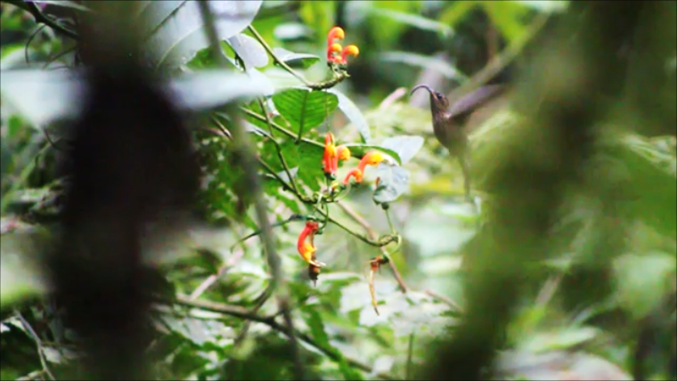
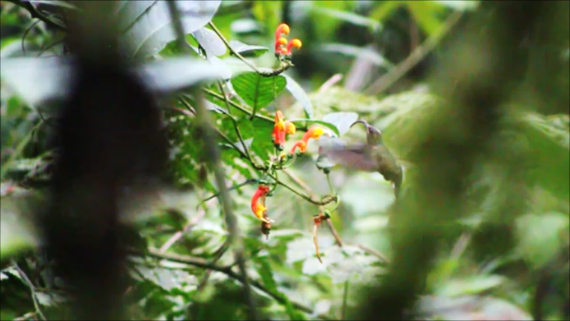
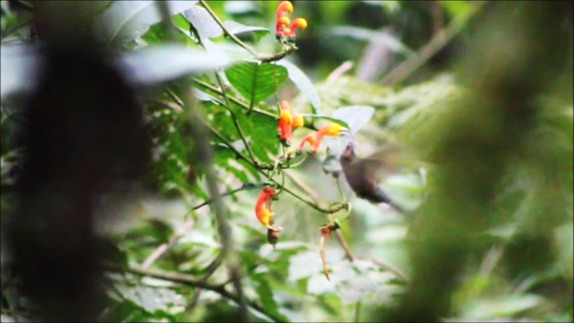
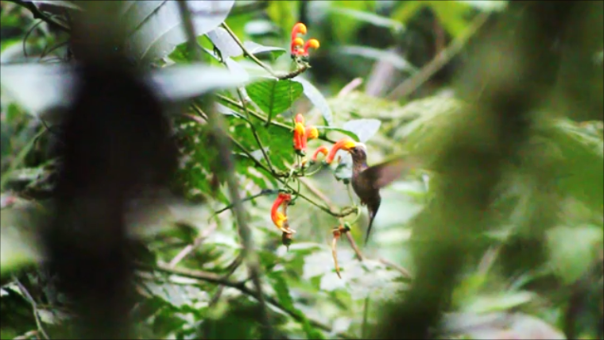
A
B
C
D

